Slide 1
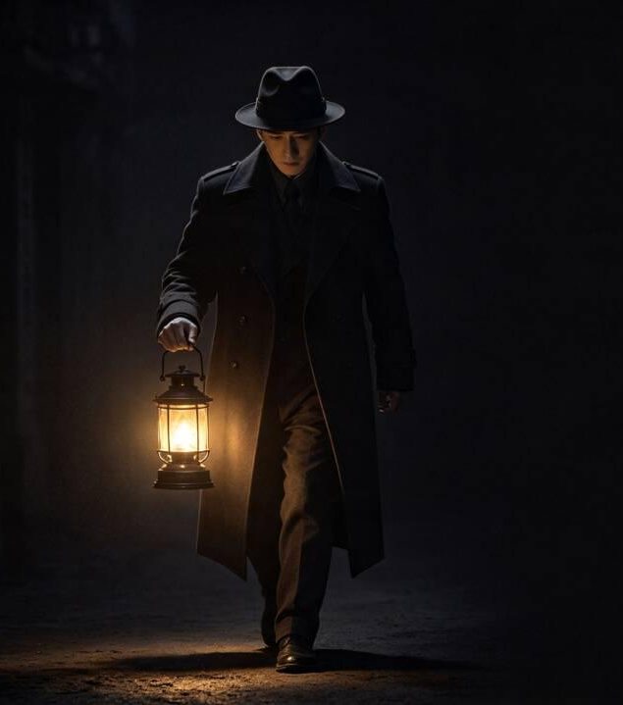

尚未结案
Open Case
2026/7/25
案
Presented by: Chen Pengyi, Chen Pengxuan, Hu Jiyu, Liu Yinuo, Huang Hongbo, Shi Zhenqi
Instructor&Mentor：Sissi，Lok，Allen，Ceci

Slide 2


Slide 3
Table of Contents
01
Case Initiation
02
Rules of Inquiry
Project Overview
Core Gameplay
03
Form, Spirit & Resonance
04
Artisan's Craft
Art & Audio
Technical Solutions
05
Timeline
06
Closing Statement
Schedule & Team Role
Summary & Outlook

Slide 4
01
Case Initiation
Not just for scares, but a descent into the darkness of the human heart.
卷

Slide 5



A New Narrative for Chinese Horror
Into the shadows of the soul
Turbulent times. Haunting folklore. One small soul against the darkness.
Background
Born from the chaos of Republican-era China, where deep-rooted superstitions and cruel customs ran rampant. Countless innocents perished in vain, their resentment festering into vengeful spirits — leaving behind a trail of unsolved, unavenged wrongs.
Goal
Players step into the shoes of a Republican-era investigator, delving into long-abandoned crime scenes. Gather clues, piece together the evidence, and unravel the truth behind cases long buried in dust.
Core Narrative
Amid the oppressive, mournful atmosphere of a nation in turmoil, players must confront vengeful spirits while breaking curses, righting wrongs, and solving cases — delivering a gameplay experience that blends exorcism, vindication, and deduction.

Slide 6

02
Rules of Inquiry
In a world of spirits,
the mind is the only weapon.
卷

Slide 7




A paranormal investigation driven by sanity
Fear fuels the hunt. Mirrors reveal the truth.
Core Mechanics
Unique Features
Scene Investigation
Inventory Wheel
A first-person exploration through Republican-era China. Gather scattered clues and piece together the fragments of a hidden truth.
A compass-style radial menu for quick access to talismans, bronze mirrors, and other tools — adding a layer of strategy to every item choice.
Basics
Controls
Sanity Meter
In the mirror
Every glimpse of the supernatural chips away at your sanity. Vision distorts. Movement slows. HP down. Let it hit zero — and death follows. Fear itself is the enemy.
Environments mirror-flipped left to right, soundtrack reversed in playback — crafting a uniquely disorienting puzzle experience that bends reality itself.
Trouble
Feature

Slide 8
03
Form,Spirit& Resonance
Step into a meticulously restored Republican era, where horror feels real.
韵

Slide 9




Art & Audio
Art · Photorealistic
Audio · Progressive
Lighting
Loops
Localized lighting carves sharp contrasts between light and shadow, using darkness itself as a tool of tension.
For chasing scenes, looping musical phrases are deployed — repetitive, escalating motifs that relentlessly amplify the player's anxiety and the visceral terror of being hunted.
Assets
Base furniture assets sourced from Fab are retextured with decay, dust, and bloodstains — then staged alongside scattered diaries and splintered wooden planks to weave environmental storytelling.
Atmosphere
During chase sequences, motion blur heightens the sense of urgency, while film grain and vignette effects unify the visual tone with a distressed, oppressive atmosphere.

Slide 10
04
Artisan's Craft
Powered by Unreal Engine, accelerated by AI
器

Slide 11
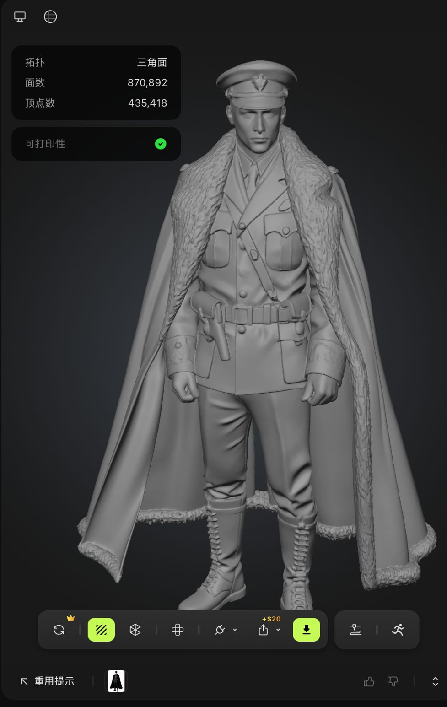



Scene & Character Modeling
"Powered by Unreal Engine, accelerated by AI"
Technical Solutions
Engine Selection
We chose Unreal Engine for its high-fidelity rendering and real-time interactivity — perfectly suited for the atmospheric lighting and first-person exploration demanded by Chinese horror.
Key Challenge
High-precision environments and characters are essential,yet we must balance authentic horror atmosphere with stable game performance.
AI辅助方案
Generative AI produces concept art, costume patterns, and architectural designs. Text-to-visual pipeline accelerates 3D modeling input

Slide 12
05
Timeline
Delivered at speed, built as a team.
务

Slide 13


Concept & Development Timeline
Concept Demo & Production Timeline
7/22
Initial Concept Design
Brainstorming sessions to define the game's setting and core mechanics
7/23
Character & Environment Design
Refine world-building and character design; proceed with illustration and 3D modeling production.
7/24
Scene modeling and team integration
Finalize scene modeling; prepare for presentation.

Slide 14




团队贡献分工
Lead Designer
Lead Artist
Story Designer
Story Designer
Story Designer
Modeler
陈芃毅
CHEN
PENGYI
石振绮
SHI
ZHENQI
陈芃绚
CHEN
PENGXUAN
刘伊诺
LIU
YINUO
黄弘博
HUANG
HONGBO
胡继羽
HU
JIYU

Slide 15
06
Closing Statement
The volumes of unearthly cases, now laid to rest.
结

Slide 16
Summary & Outlook
Three volumes of cases, brought to light.
Summary
Outlook
Overall design of a mystery horror game
Expand complete storyline and refine world-building
Oppressive,eerie atmosphere through dark visual style
Add new exploration maps
Dual Health & Sanity survival system
Upgrade Sanity system with custom VFX
Improved narrative design, level layout, and teamwork skills
Introduce multiple endings for richer player experience
The cases are never truly finished......

Slide 17
诚惶诚恐·稽首致谢
Not just a story. An obsession.
Thank you for your listening.
谢

